Slide 1

What do I Show the External ISO Auditor?
©Integrated Risk Management irmsystems.com.au

Slide 2

What do I Show the Auditor?
So, the external ISO auditors are coming to your site soon and your team are a bit nervous.
What do your management, operational and service delivery staff need to show the external auditor?
©Integrated Risk Management irmsystems.com.au

Slide 3
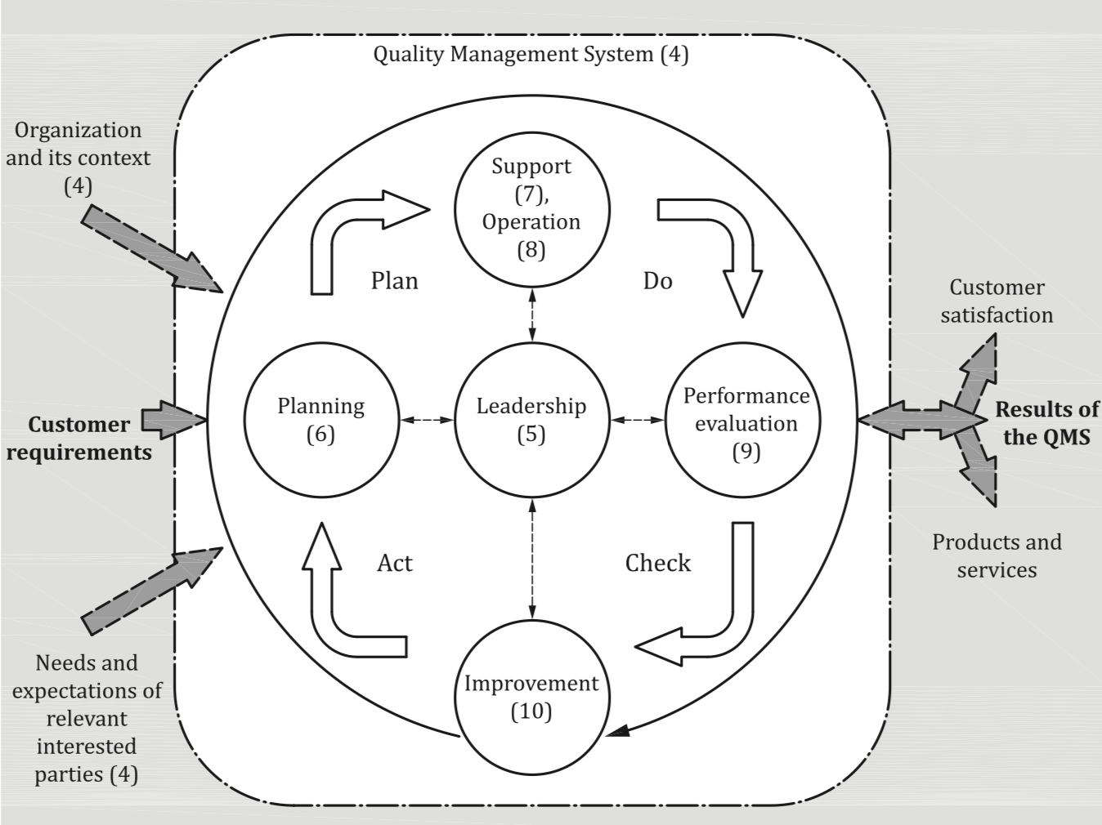
What Will I Be Audited Against?
Senior management - Section 5.
Management may also be interviewed in relation to other Clauses (e.g. 7.1 Resources).
Operational/ service delivery role – procedures, work instructions related to your tasks.
©Integrated Risk Management irmsystems.com.au

Slide 4
What do I Show the Auditor?
The auditor is seeking objective (factual) evidence. When auditing a management or operational process - key sources of evidence include:
Observations
Records
Demonstrating how you perform a task (e.g. setup a machine, plan a project) can be a great way of providing the evidence an auditor needs.
Allow the auditor to verify consistent performance of a process over time.
May not be required for every step.
Interviews
Documents
Helps an auditor verify that staff have understand how to implement workplace tasks in accordance with procedures.
The auditor may also request related documents (e.g. reports, plans, correspondence, work instructions).
©Integrated Risk Management irmsystems.com.au

Slide 5
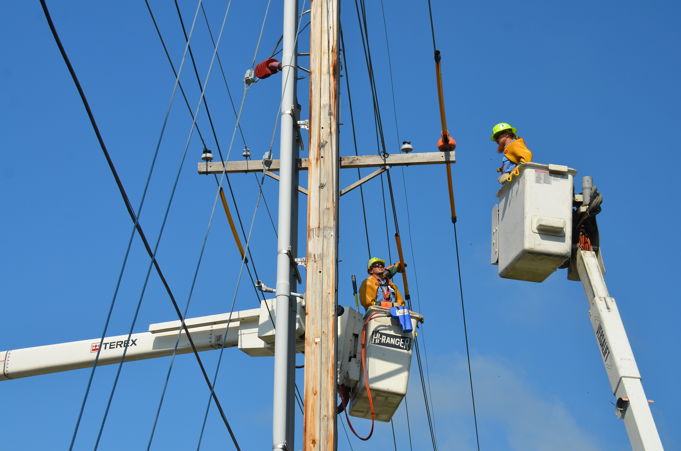
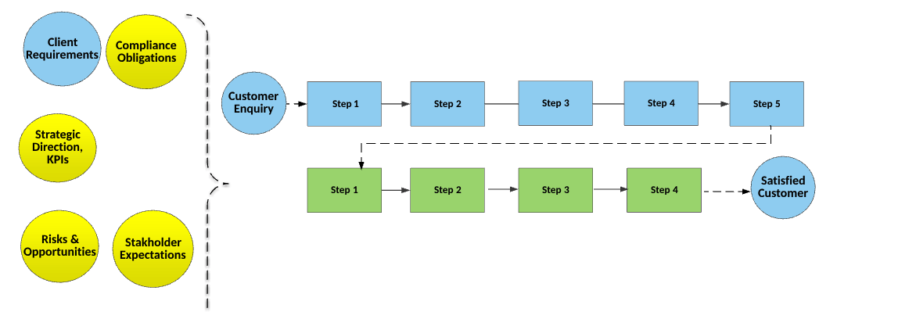

What do I Show the Auditor?
Evidence that our operational/ service delivery processes are planned, supported, controlled, monitored and improved.

Slide 6
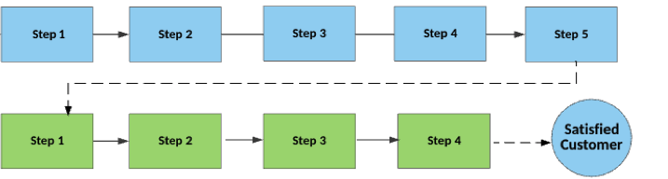
What do I Show the Auditor?
Take the auditor step by step through the process and show them related records, documents, answer questions or demonstrate the process (observation).
Where possible – use a current example (e.g. a current project, batch or job).

Slide 7
What if I don’t Understand What the Auditor is Asking?
That’s ok – ask the auditor to re-phrase the question or give you an example. Alternately, seek clarification from your Supervisor.
What if the auditor asks me about steps in the process
I don’t perform?
Let the auditor know that you are not responsible for those steps.
Direct them to the responsible person or seek advice from your Supervisor.

Slide 8
Thank You
+61 420307709
support@irmsystems.com.au
www.irmsystems.com.au
©Integrated Risk Management irmsystems.com.au

